Slide 1

Will AI Take Your Job?
ADSP 32018 IP02 Natural Language Processing
Final Project
William DeForest
Notes:
<a href="https://storyset.com/business">Business illustrations by Storyset</a>
<a href="https://storyset.com/technology">Technology illustrations by Storyset</a>

Slide 2
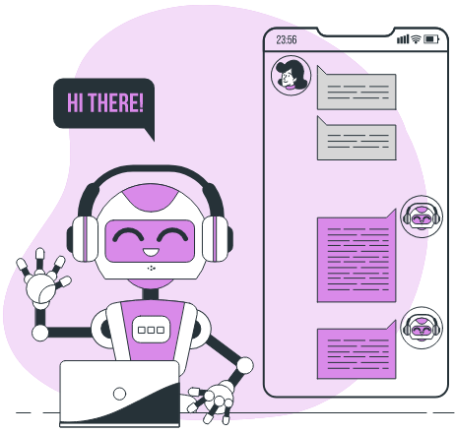
Agenda
01
02
03
04
05
06
07
Executive Summary
Data & Methodology
Article Cleaning & Filtering
Top Industries for AI Integration
Sentiment Analysis
Key Orgs, Products, & People
Recommendations - Work With AI, Not Against It

Slide 3
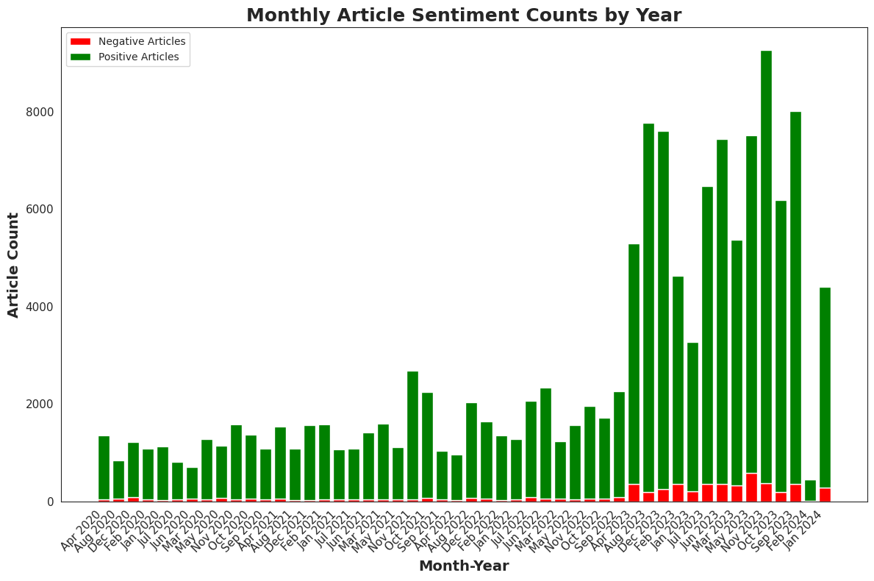
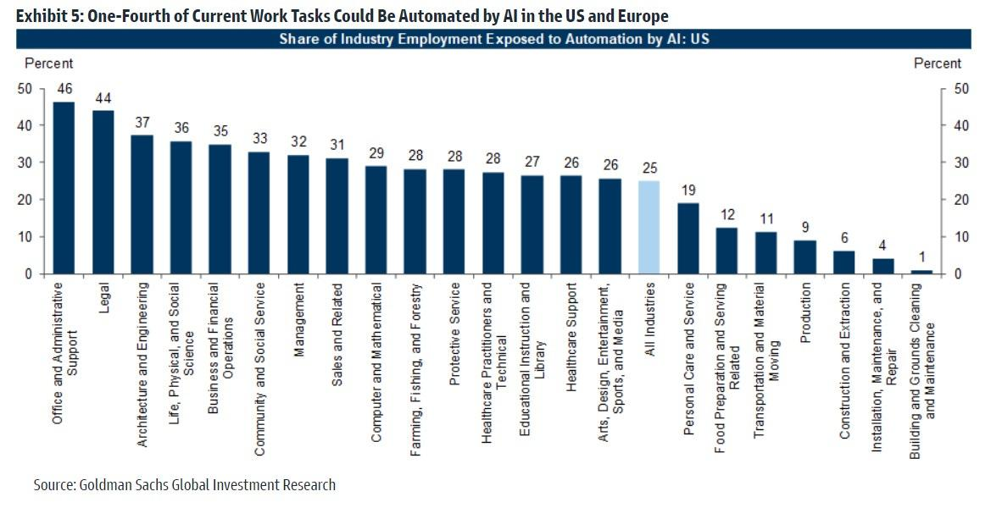
Executive Summary
Background & Context
Problem & Methods
Findings & Next Steps
The recent renaissance in artificial intelligence (AI) is set to transform industries by automating tasks and enhancing efficiency.
In fact, Goldman Sachs recently published a report in which they estimate that 25% of current work tasks can be automated by AI.
This project aims to identify what types of tasks and jobs are most likely to feel the largest impact from the advent of AI. These insights are invaluable as they can help people identify strategies to make AI work for them rather than have AI replace their work.
A collection of ~200k news articles related to AI, machine learning (ML), and data science (DS) were made available for analysis
To achieve this objective, a variety of natural language processing (NLP) techniques such as topic modeling, sentiment analysis and named entity recognition are employed
Sentiment around AI is overwhelmingly positive
Some areas will be hit harder than others:
The semiconductor industry will continue to explode as computing demand grows
Administrative and content creation roles face significant automation
ChatGPT is losing hype, but it's true value as a tool for building new applications will be realized
Paddling hard before the AI wave hits will be the key to riding it to a brighter future.

Slide 4
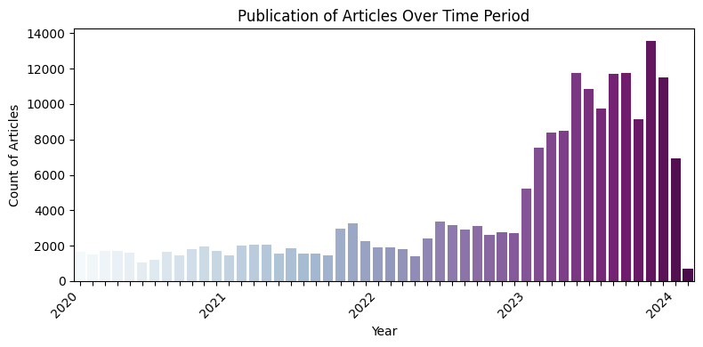
Source Data
Methodology
~200k news articles
Article titles and text are cleaned using regular expression pattern matching.
Extremely short/long articles and articles lacking data science, machine learning and AI keywords are filtered out.
Key topics and industries are identified using Latent Dirichlet Allocation (LDA) topic modeling from GenSim and ktrain.
An SVM sentiment analysis model is trained on an open-source corpus of ~4.6k news articles.
This model is applied to each sentence of each article and aggregated to determine article sentiment.
Named Entity Recognition (NER) is performed at a sentence level using spaCy’s large English pipeline trained on written web text (en_core_web_lg)
Targeted sentiment analysis is conducted by combining article topics, entities and sentiments and analyzing their changes over time
Published between 2020-2024
Collected using a web crawler
Focused on data science, machine learning and artificial intelligence topics
Features include article title, text, url, publish date, and language (all in English)
As a result of the web scraping, the raw article text is noisy
Website headings, links and other errors irrelevant to the article are removed

Slide 5
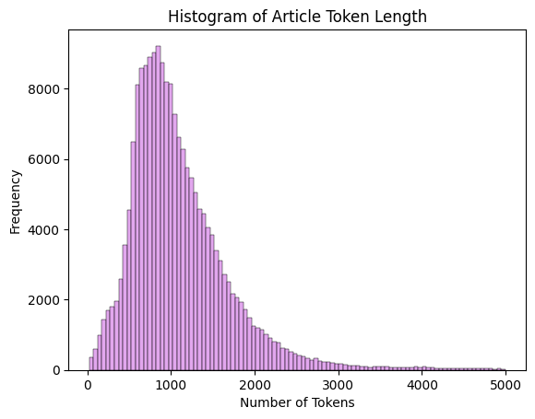
Article Cleaning & Filtering
1
2
3
4
Media outlet name was removed from the article title if present
URLs, links, special characters and exceptionally long word (15+ characters) were removed from article text
Common web crawl remnants unrelated to articles (‘Cookies’, ‘Contact Us’, ‘Subscribe’, etc.) were removed
A common structure for website headings was several capitalized words in a row. When five or more were in a row, they were removed.
5
6
Top 10 Keywords
~193k Cleaned & Filtered Articles
Tokenized articles and filtered out extremely short/long articles.
Too short < (1/50)*mean token count
Too long > 5000 tokens
Combined clean title and text tokens and used nltk’s FreqDist to find the top 100 most common tokens. Chose top 10 AI, ML, Data Science keywords, enriched with related ChatGPT generated keywords, and filtered out articles missing these tokens in the first 20% of the article.
Ai
Data
Intelligence
Artificial
Technology
ChatGPT
Learning
Generative
Machine
Analytics

Slide 6
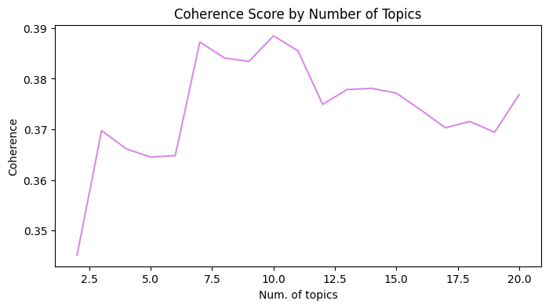
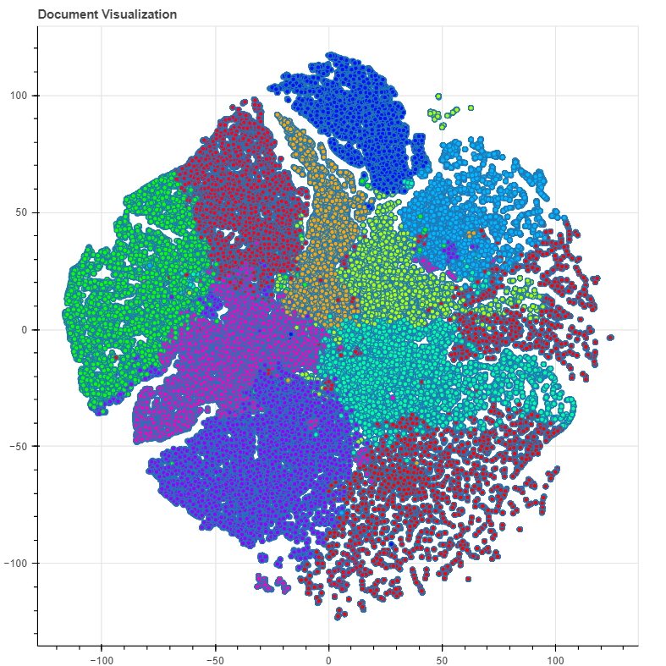
Topic Modeling to I.D. AI-Impacted Industries
LDA Topic Modeling (ktrain)
LDA Topic Modeling (Gensim)
Using the optimized n = 10 topics from Gensim LDA, ktrain topic modeling was performed due to ktrain’s superior topic analysis capabilities.
Analyzing the word distributions and the summaries of top-ranked articles for each topic, six clear areas being impacted by AI emerged.
Coherence = 0.388
Word Distributions of Top 6 Topics
2: machine, model, learning, network, computer, application, human, algorithm
4: customer, service, experience, generative, platform, process, enterprise
5: patient, health, care, medical, study, clinical, disease, cancer, improve
7: risk, human, student, need, concern, job, government, world, tech
8: user, model, chatgpt, chatbot, tool, email, image, language, search
9: open, video, game, create, voice, feature, people, icon, good
n = 10
6
Gensim LDA Topic Modeling was performed on a sample of 10,000 articles. Coherence score was calculated for n = 2-20 topics.
Coherence score (a measure of how meaningful and interpretable the identified topics are) is maximized at n = 10 topics.
9
1
5
3
2
8
4
7
0

Slide 7




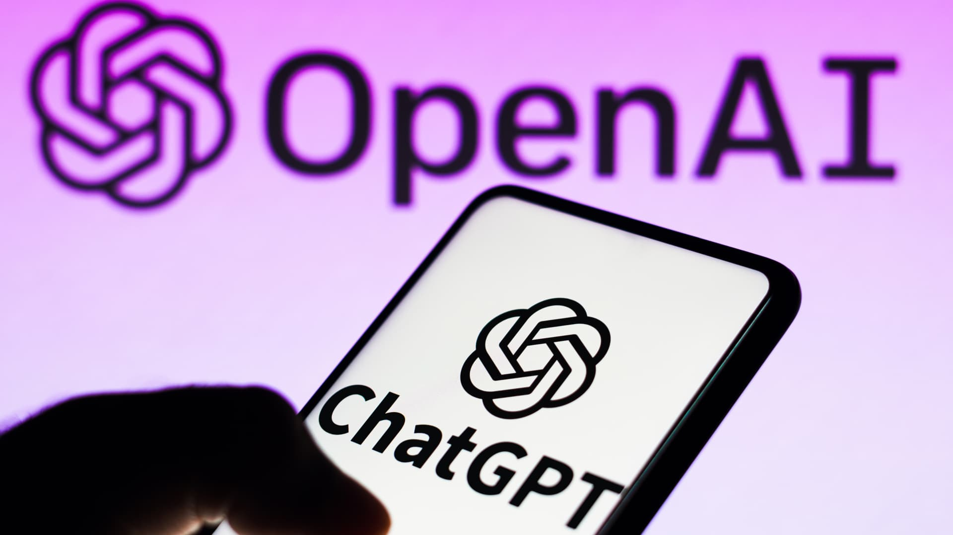

Interpreting ktrain Topics: Text Summarization
The TransformerSummarizer from ktrain was used to summarize the 50 top-ranked articles for each topic. These summaries provided additional insight and aided in the identification of the following industries/areas.
2 Semiconductors
4 Conversational AI
5 Healthcare
Summary Excerpt: “chip chip artificial intelligence chip specialized processor design ”
Summary Excerpt: “vast amount datum improve service enhance customer experience”
Summary Excerpt: “recent clinical trial combination immunotherapy nasopharyngeal cancer”
7 AI Regulation
8 ChatGPT & LLM’s
9 Entertainment
Summary Excerpt: “concern regard artificial intelligence repeatedly warn potential danger”
Summary Excerpt: “restrain request rate thus limit collection datum high traffic site analitici”
Summary Excerpt: “light big rays design design design light big ray design designdesign”

Slide 8
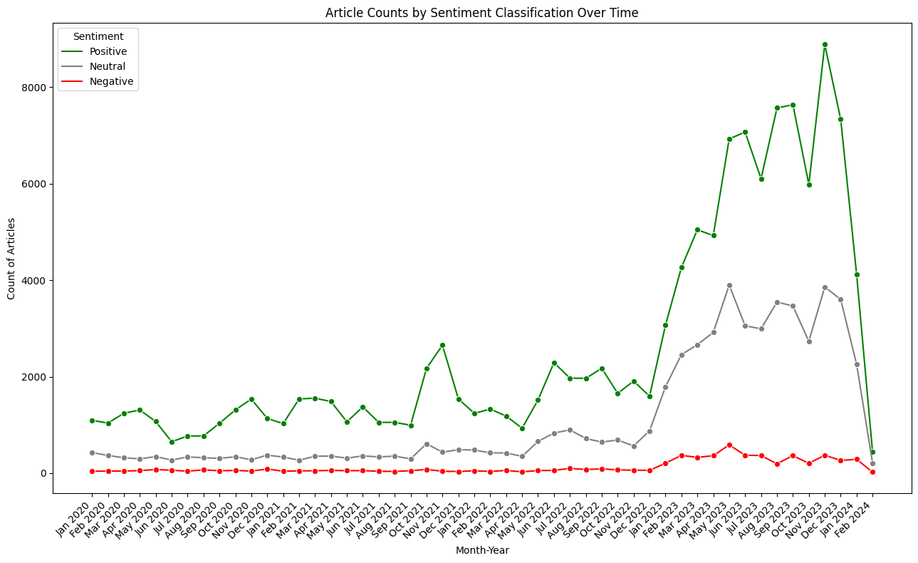
Sentiment Analysis: AI Industry Overall
Custom SVM Classifier
Altman fired, then rehired, from OpenAI
GPT-4
Released
A custom SVM classifier was trained on the ‘ML-news-sentiment’ dataset from Hugging Face.
Dataset contains 4.6k news articles
Labels: positive, neutral, or negative.
Chosen because it is trained on news articles (rather than other forms of text such as reviews) and because it provides a neutral classification. Often, the factual or descriptive statements in news articles have no clear sentiment. Rather than inaccurately classifying these statements as positive/negative, this model labels them as neutral.
ChatGPT released
GPT
Store launch
GPT-3 released
Articles were chunked into sentences using spaCy’s sentence recognizer ‘senter’ and the customized sentiment model was deployed at the sentence level. As can be seen above, sentiment surrounding AI, ML and DS was overwhelmingly positive from the start of 2020 through 2023, though a waning count of articles written in early 2024 could warn of a potential “AI winter”

Slide 9
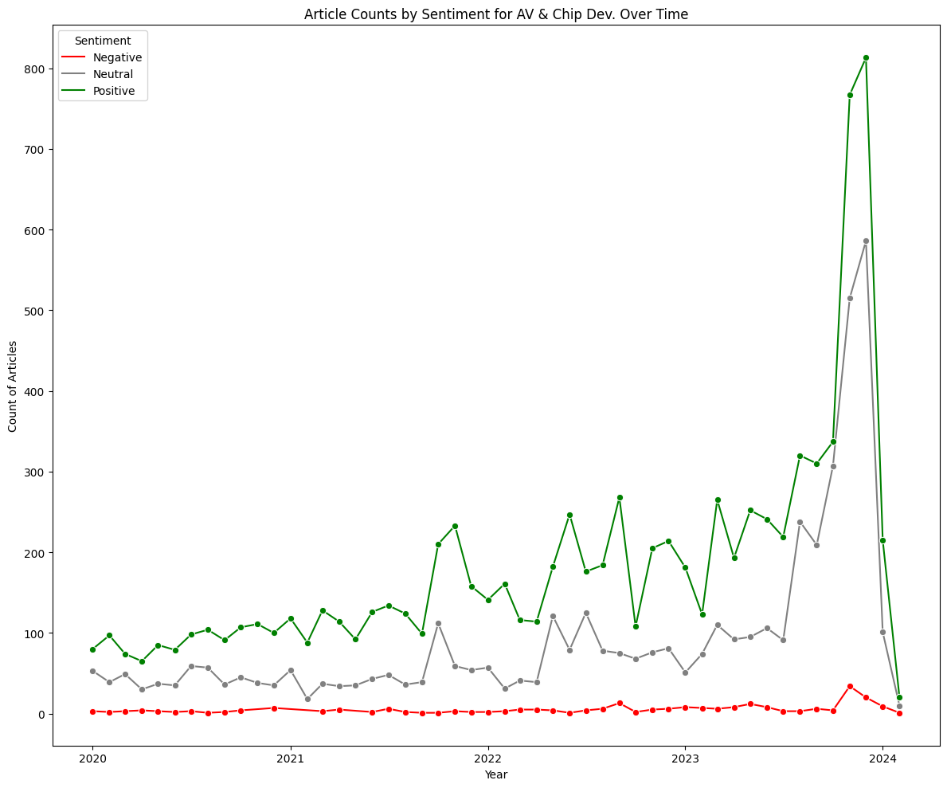
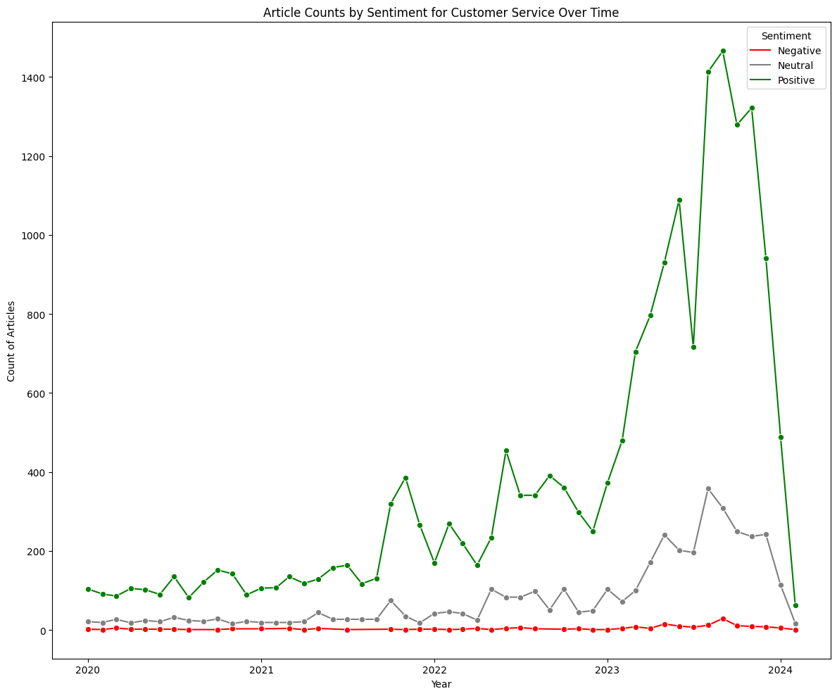
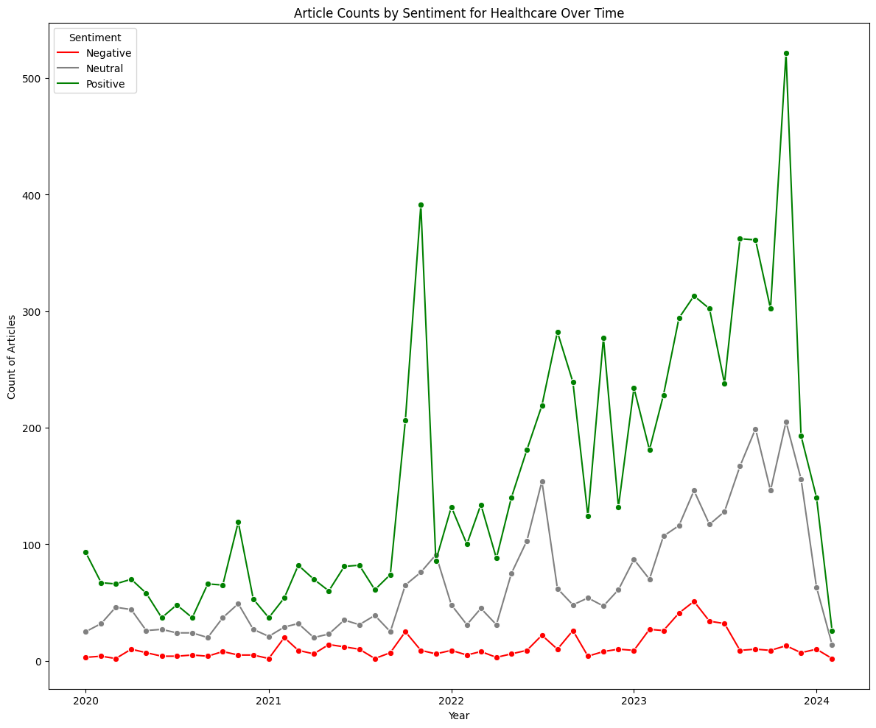
Sentiment Trends Provide Insight Into Burgeoning Or Contracting Industries (1/2)
Semiconductors
Conversational AI
Healthcare
Investigating the sharp increase in positive sentiment in late 2023 reveals that NVIDIA has seen a massive increase in stock price as demand for its AI-powering chips reaches fever pitch
Positive sentiment around conversational AI has risen hand-in-hand with LLMs as ChatGPT, PaLM 2, and Bard showcase strong question answering capabilities - a key for conversational AI applications
Relative to other industries, healthcare has seen gradual growth in positive sentiment and has had more variation in negative sentiment. There is massive potential in the automation of admin. work, but data confidentiality concerns and regulation are slowing progress

Slide 10
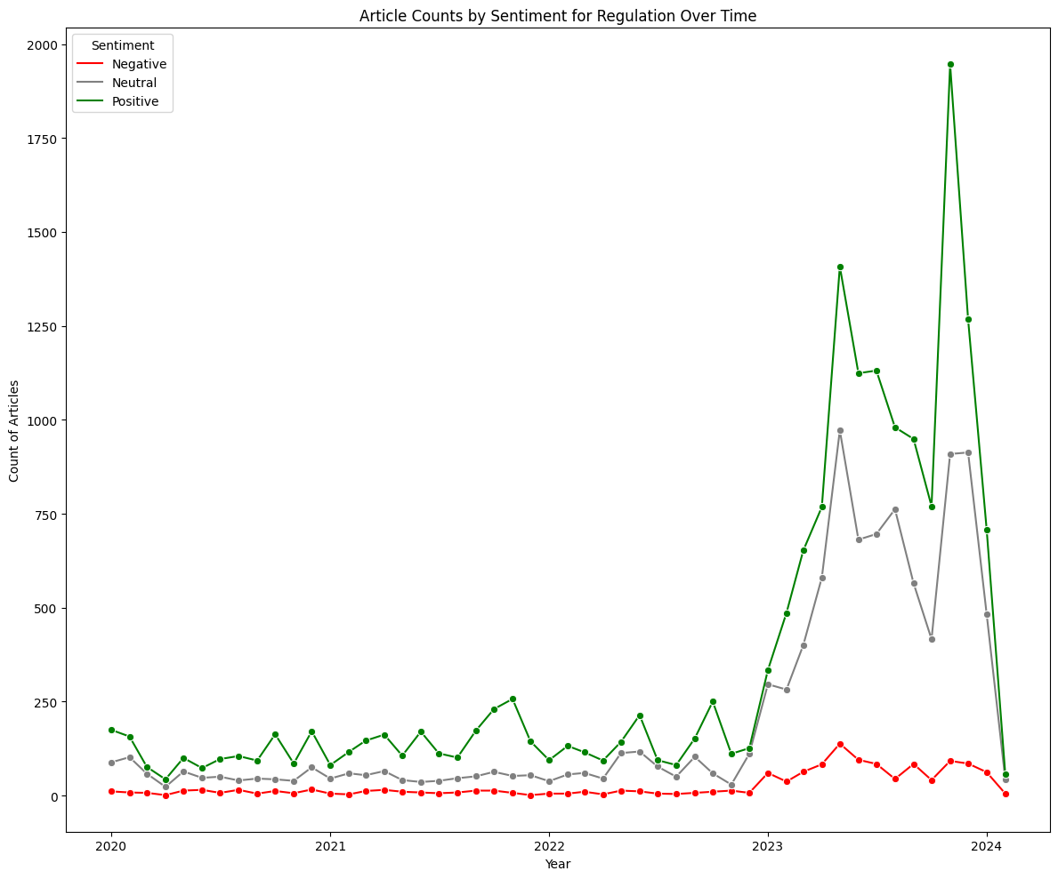
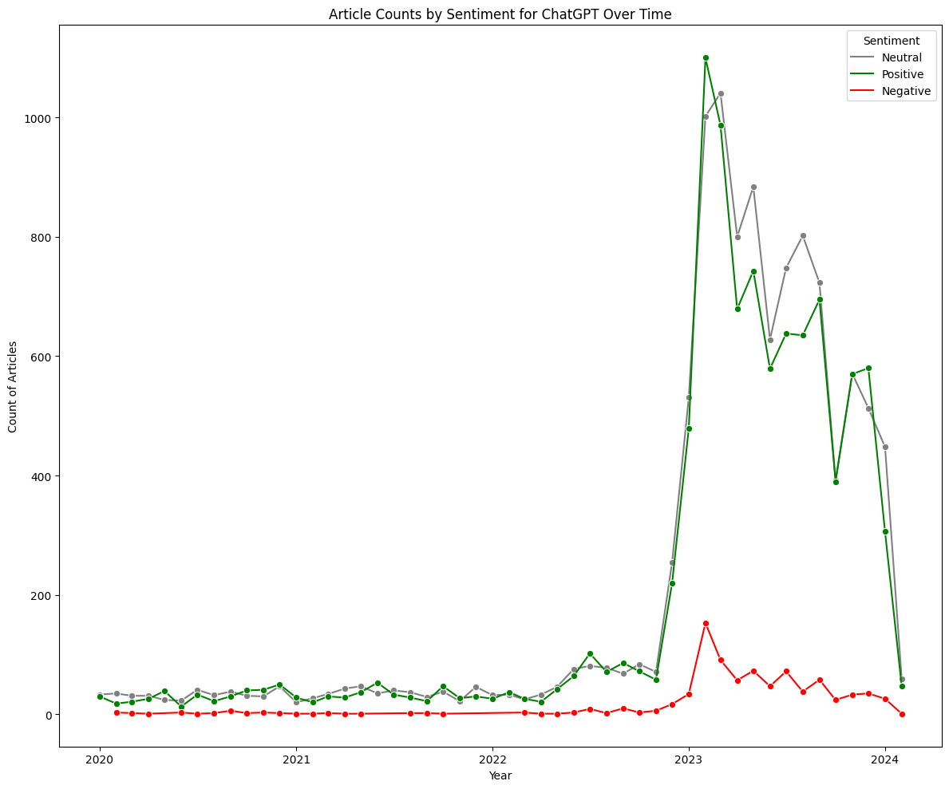
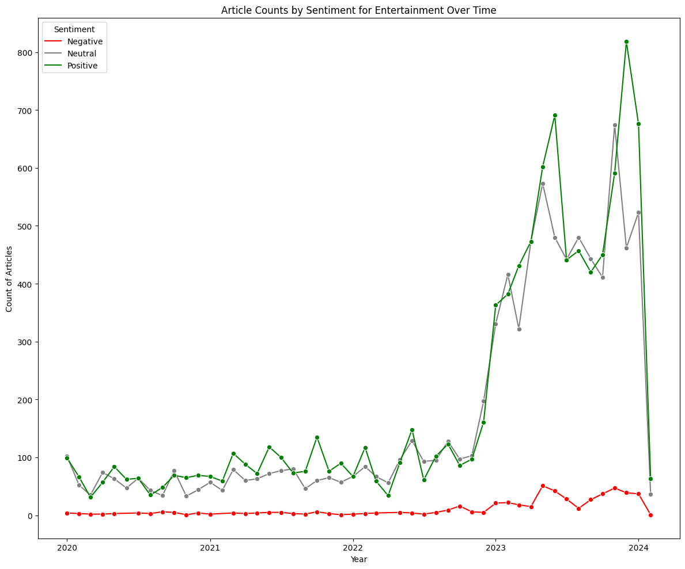
Sentiment Trends Provide Insight Into Burgeoning Or Contracting Industries (2/2)
AI Regulation
ChatGPT
Entertainment
AI regulation peaks in positive sentiment simultaneously with major OpenAI news. The first rise begins in late 2022 with the release of ChatGPT. The highest peak occurs in conjunction with the firing of Sam Altman which set off the AI acceleration vs. alignment debate
ChatGPT is such an integral feature to the AI landscape that it’s an entire topic. However, after its initial spike, we see decreasing positive sentiment and high levels of neutral sentiment, This trend suggests that ChatGPT is losing its novelty and becoming a more mature constituent of the space
Positive sentiment regarding AI in the entertainment industry has largely followed breakthroughs in generative AI - releases of ChatGPT and the multimodal GPT-4. While breakthroughs, they raise thorny questions around intellectual property and threaten many creative jobs

Slide 11
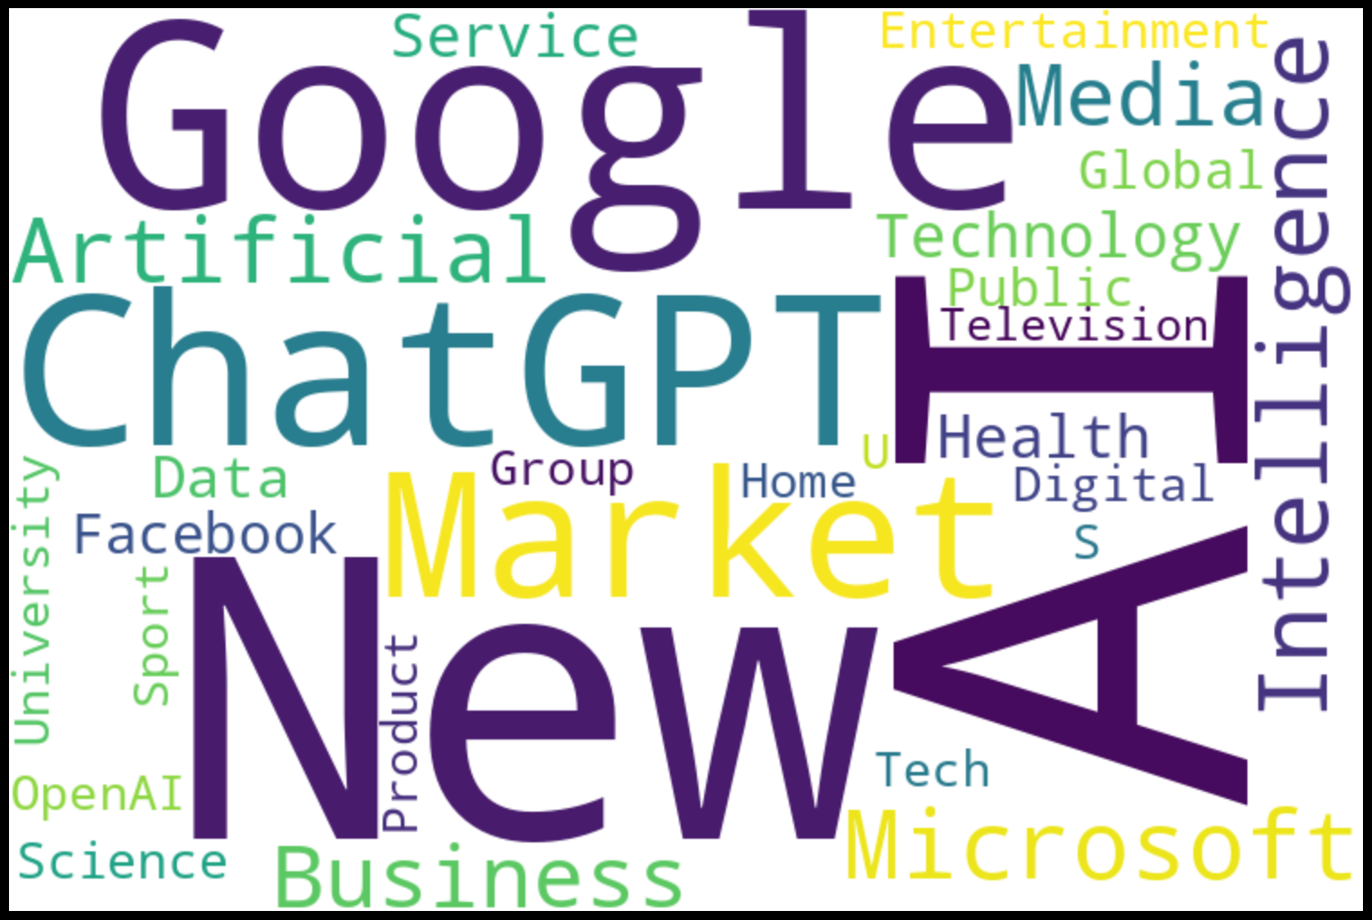
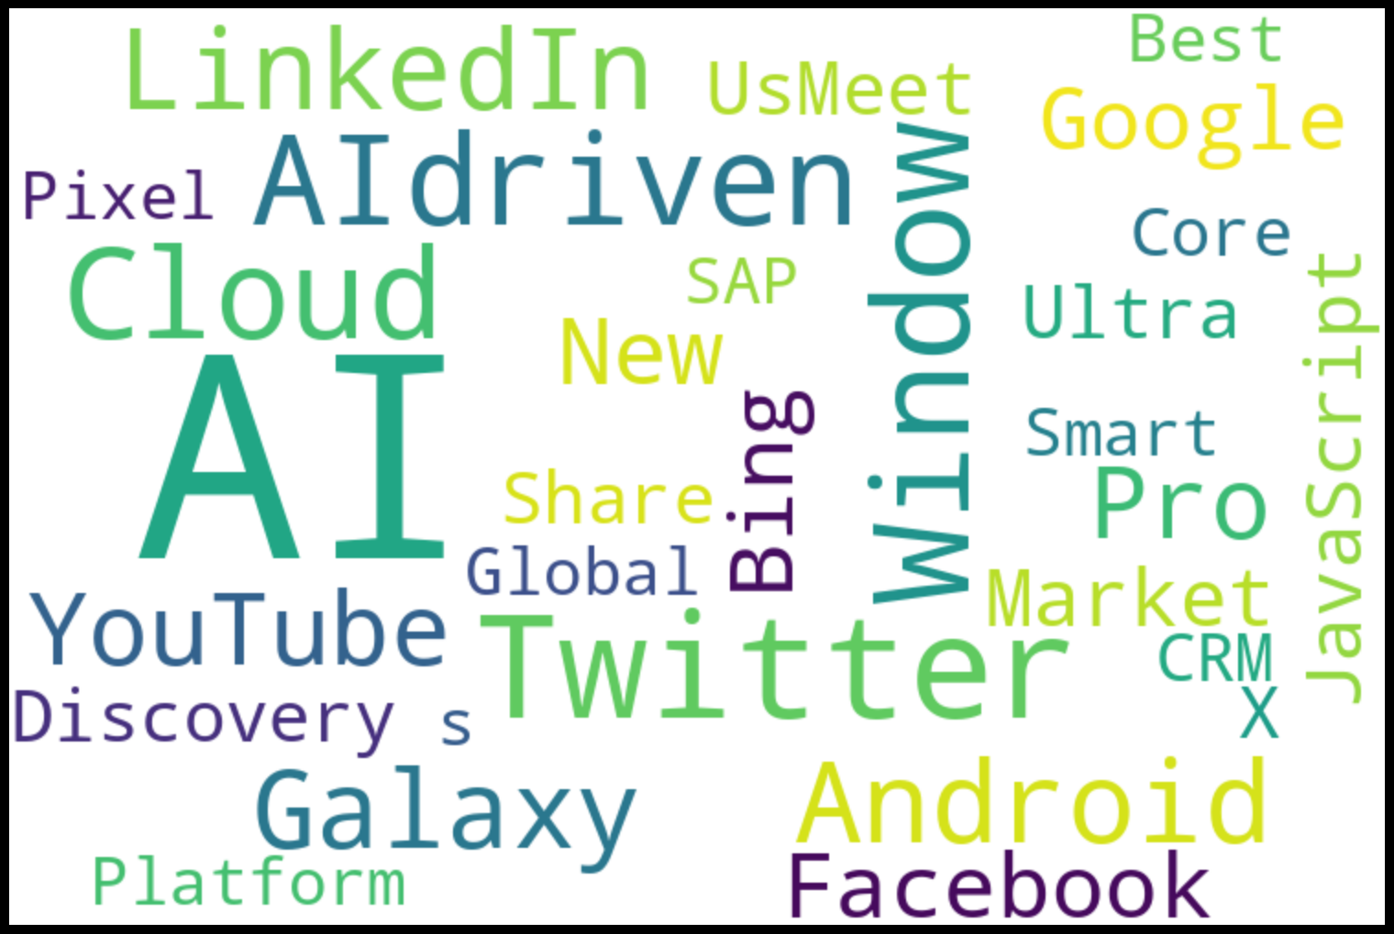
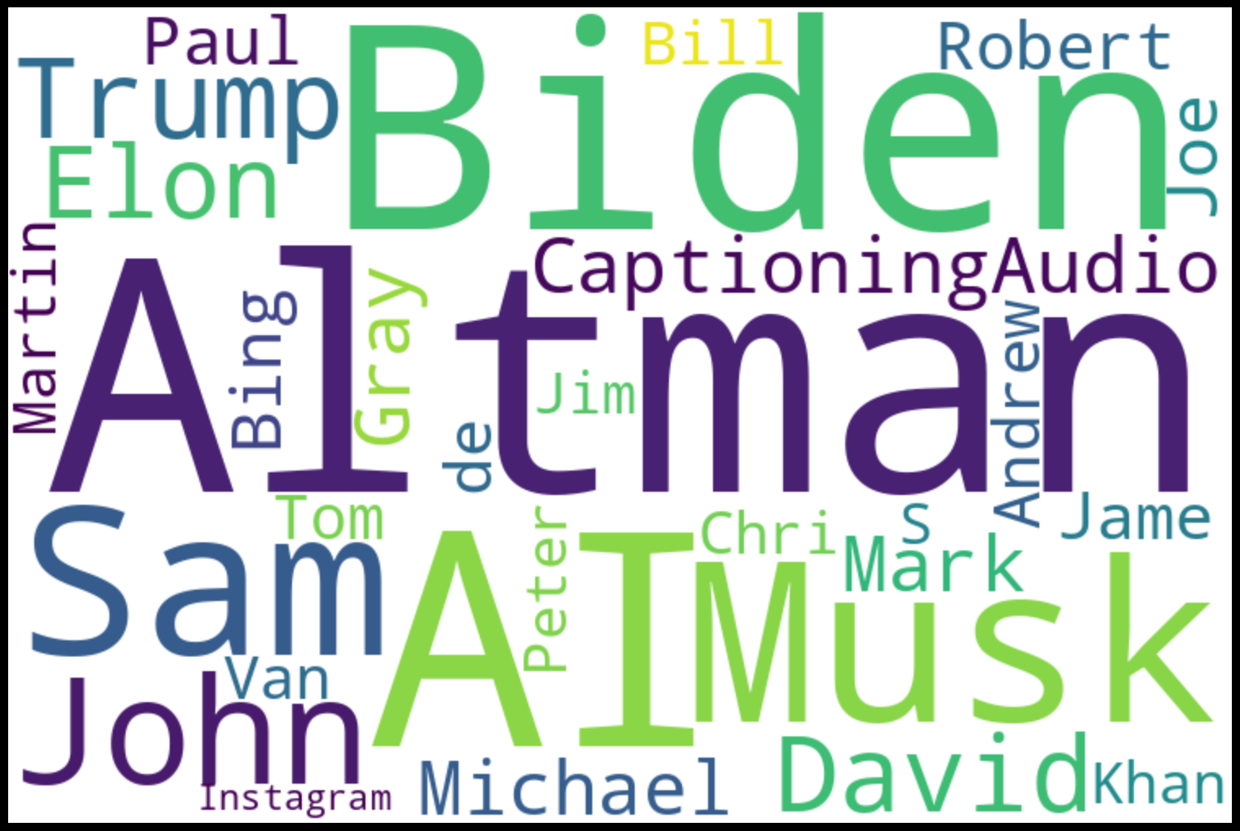
Named Entity Recognition (NER) Identifies the Organizations, Products, and People Driving AI
Named Entity Recognition (NER) was performed using spaCy’s “en_core_web_lg” model. A pipe with only “ner” enabled was used to perform NER at the sentence level.
Organizations
Products
People
The organizations mentioned most frequently include Google, Microsoft, Facebook and OpenAI. Unsurprisingly, these organizations are the world’s premier tech companies and are leading the way in AI R&D. ChatGPT is technically a product, but is so mainstream that it’s often referred to like a company
Top AI, ML, DS products include YouTube, Galaxy, Bing and LinkedIn. YouTube is a major source for learning about AI, Bing was integrated with the Copilot chatbot in early 2023, and Galaxy phones by Samsung are one of the first to integrate AI on-device. LinkedIn is an important connector of top AI talent
OpenAI CEO Sam Altman, President Joe Biden, and Tesla and xAI founder Elon Musk are the largest figures in the AI space. Altman for his role mainstreaming Generative AI, Biden in his position of balancing AI acceleration and regulation at the national-level, and Musk as a general, and very outspoken, leader in tech

Slide 12
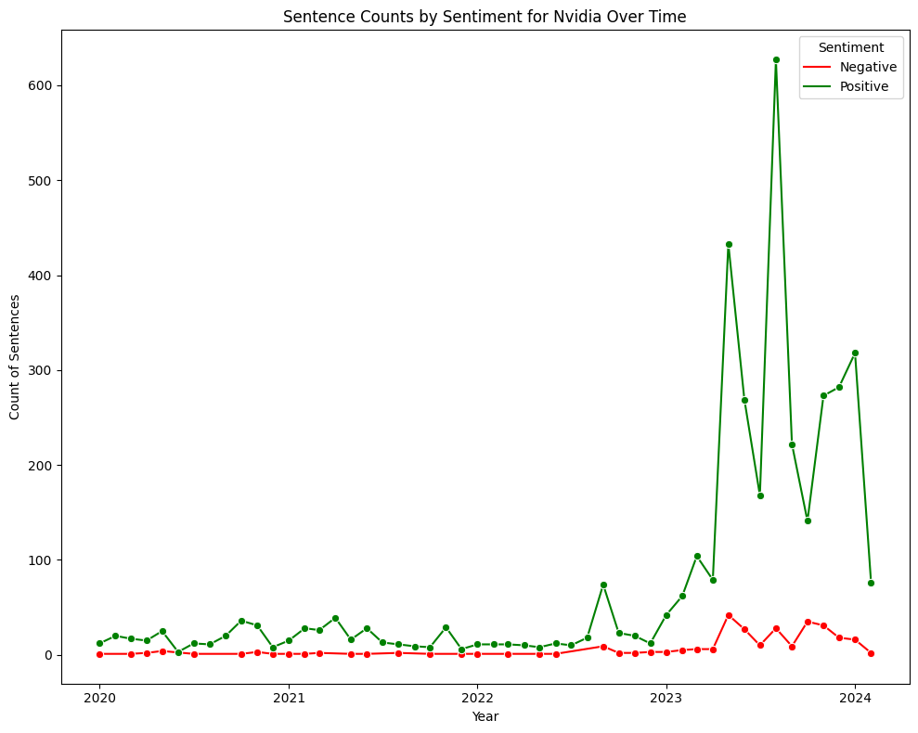
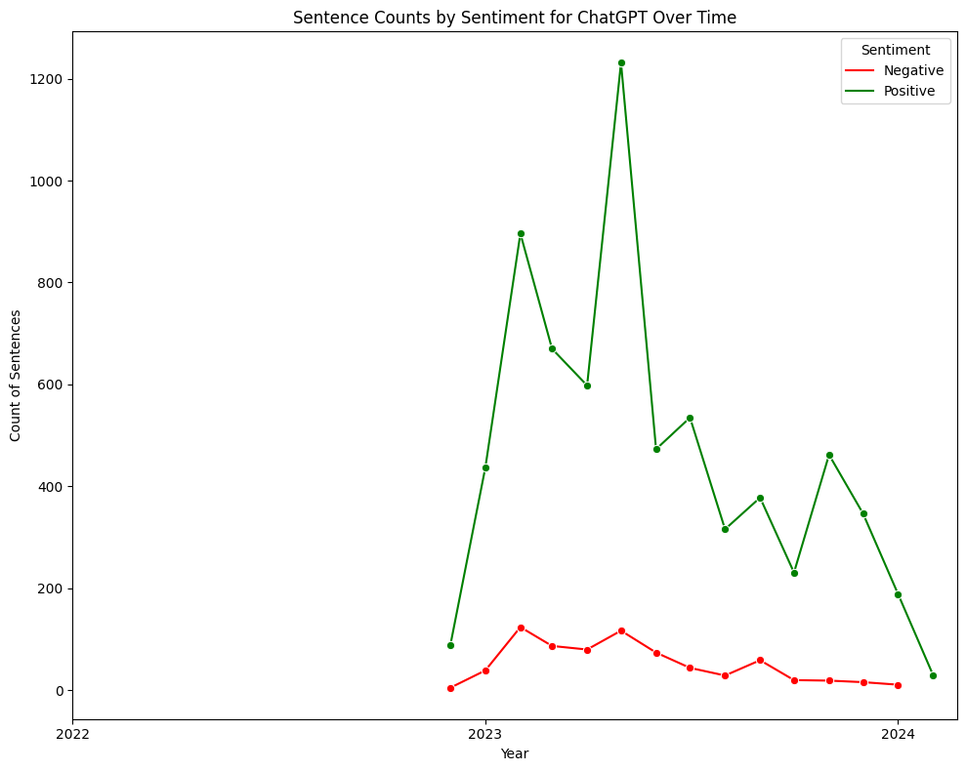
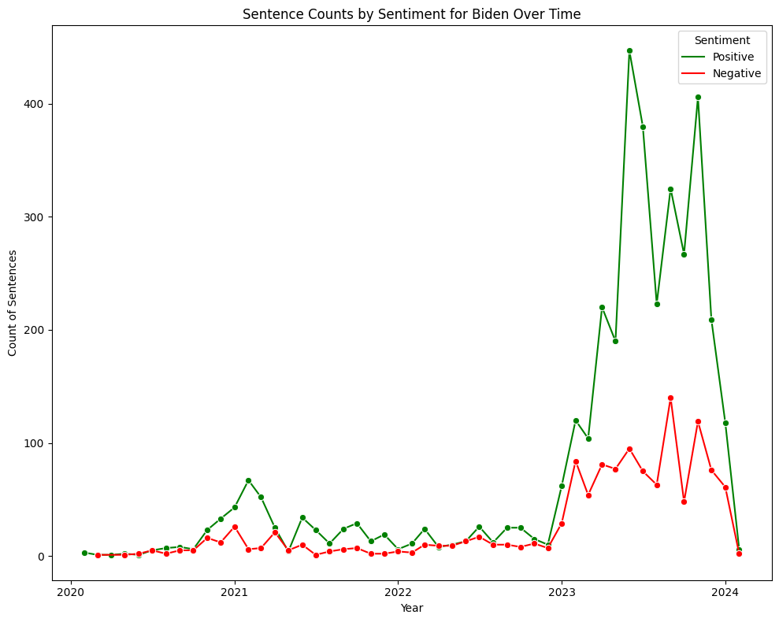
Targeted Sentiment Analysis of Important Entities In Their Respective Industries
Semiconductors
ChatGPT
AI Regulation
The positive sentiment around Nvidia jumped significantly in 2023. This reflects investors’ excitement around Nvidia’s positioning in the booming semiconductor manufacturing market.
Positive sentiment around ChatGPT (entity) declined during 2023, despite the release of industry-leading GPT-4. This shows that ChatGPT is losing hype as competitors have produced similarly performing models.
Sentiment regarding President Biden is significantly mixed. While partially due to political polarization in the U.S., we do see a spike in negative sentiment in Oct. 2023 when Biden issued an executive order establishing AI safety and security standards.

Slide 13
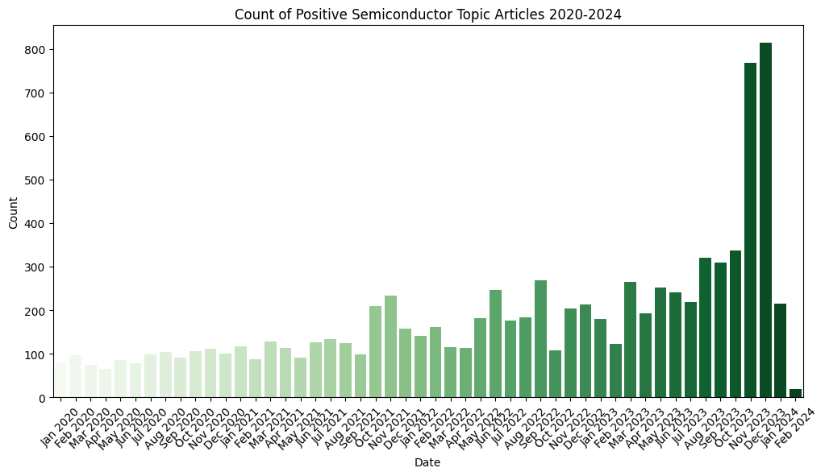
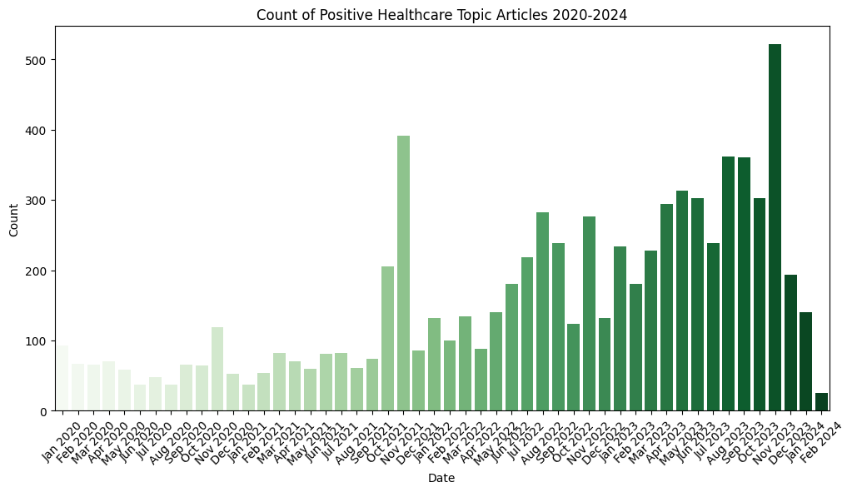
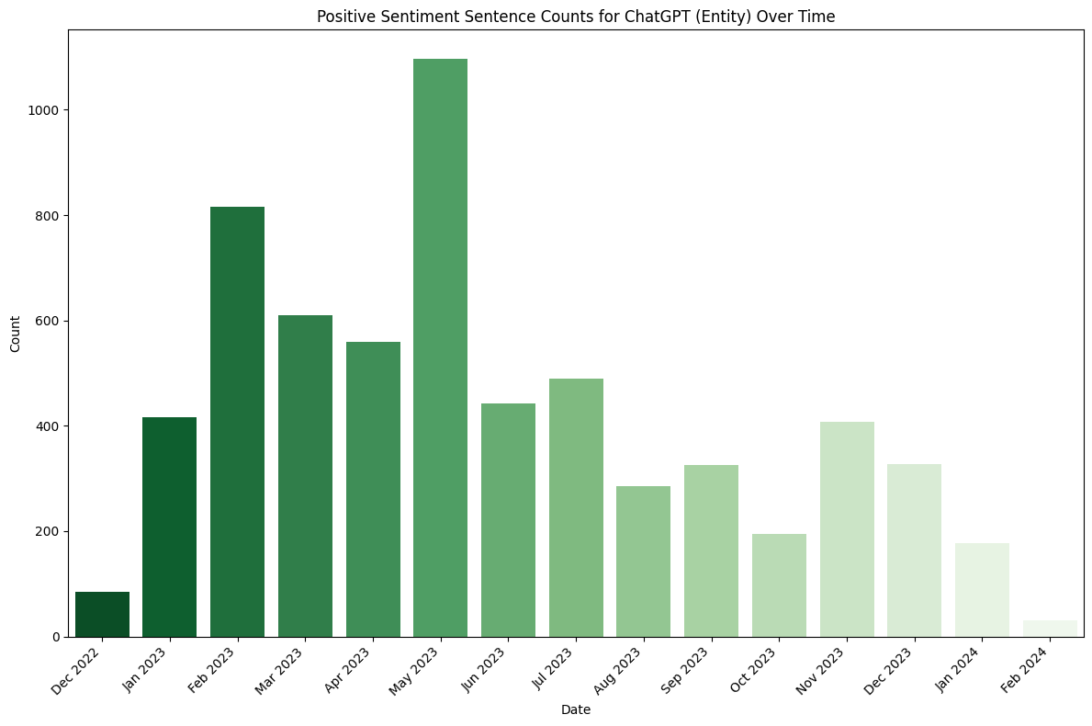
Findings & Next Steps → Recommendations
1. Invest in semiconductor/chip manufacturing. Furthermore, learn how to use a GPU!
While the semiconductor market has been red-hot, it is well warranted. Only a handful of companies like Nvidia, AMD and Intel have the infrastructure to build these high performance chips. There is strong positive sentiment and demand is likely to increase as more AI products are built. Learn how to leverage this powerful tech before it replaces you.
2. Administrative and content generation roles are at particular risk of being automated by AI.
The repetitiveness of admin. tasks and the sheer amount of training data available for content generation have people excited about AI automation in these areas. If you are in such a role, embrace AI and use it to improve your work. You are already an expert and have a step ahead of everybody else. Don’t let them catch up by refusing to accept AI.
3. ChatGPT is losing its novelty and hype. Take this opportunity to separate yourself from others.
While the hype of ChatGPT is dying down, it is still the most powerful tool the world has ever seen. Industries like healthcare and entertainment will experience major overhauls as new GPT iterations augment existing, or invent new, processes. Educate yourself about LLMs, learn the basics of integrating them into existing structures and then get creative. Use ChatGPT to create a new job for yourself, rather than waiting around for it to take yours.

Slide 14




Thanks!
Do you have any questions?
wdeforest@uchicago.edu
+1 206 678 6215
https://github.com/wdeforest23
Animated images were created by StorySet

Slide 15
References
Goldman Sachs Article: https://www.aei.org/articles/why-goldman-sachs-thinks-generative-ai-could-have-a-huge-impact-on-economic-growth-and-productivity/
Sentiment Analysis Training Data:
https://huggingface.co/datasets/sara-nabhani/ML-news-sentiment?row=3
Animated Images:
https://storyset.com/search

